Slide 1

Έργο CYberSafety Ένα καλύτερο διαδίκτυο για τα παιδιά στην Κύπρο (Safer Internet Programme – Better Internet for Kids)
Συνάντηση εταίρων του έργου
Τετάρτη, 9 Οκτωβρίου 2019
Λευκωσία
Ζέτα Καπιτσάκη, Πασχάλης Μπέης
Πανεπιστήμιο Κύπρου
Agreement number: INEA/CEF/ICT/A2018/1614254 Action No: 2018-CY-IA-0012

Slide 2

Researcher’s Night (Activity 1)
Sept. 27th (and Sept. 26th)
Participated together with CUT
Activities:
Presented eFollowMe web game, and gave leaflets of the game
Explained importance of CYberSafety II project
Talked to children and parents about helpline/hotline
Listened to suggestions and worries from parents
What their children do online
Are the apps they use safe
Control their web and app usage on tablets

Slide 3
WEBIST conference (Activity 1, Activity 6)
Presentation of App Privacy Analyzer at WEBIST 2019 conference
(International Conference on Web Information Systems and Technologies)
18-20/09 in Vienna
Tool for more technical users

Slide 4
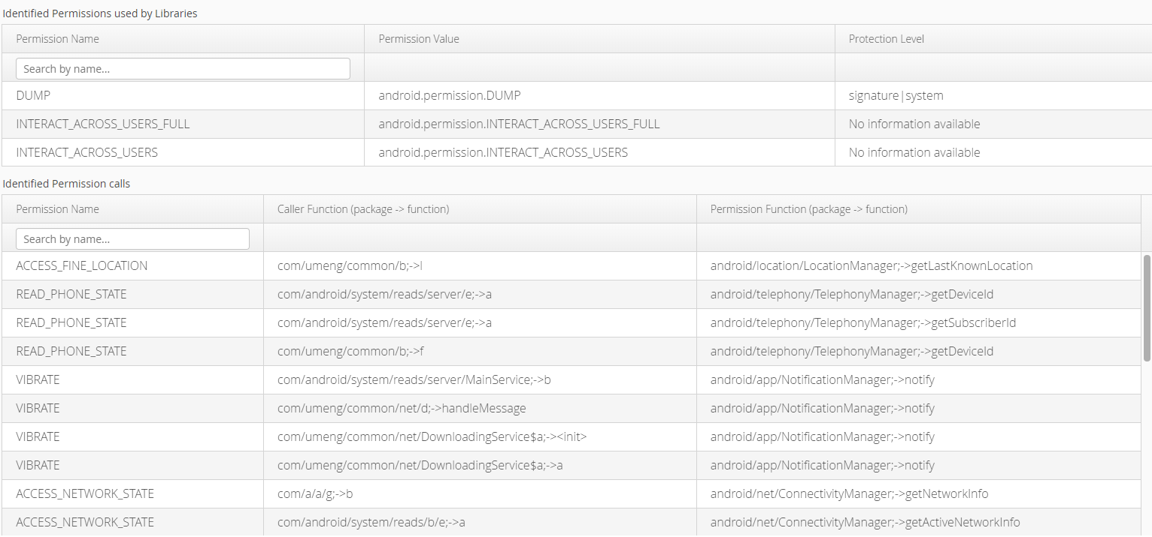
WEBIST conference (Activity 1, Activity 6)

Slide 5
T4.1 Development of a Privacy awareness tool
PrivacySaferII browser extension
New version of our former PrivacySafer
web browsers: Android Chrome, Mozilla Firefox
English and Greek

Slide 6
PrivacySaferII
Deliverables
D.4.1.1. Main GDPR guidelines for students and parents
D.4.1.2. Requirements of browser extension
D.4.1.3. Design of browser extension
D.4.1.4. Implementation of browser extension – 1st version expected 11/2019
D.4.1.5. Browser extension user guidelines

Slide 7
PrivacySaferII
Implementation of front end
Use of React JavaScript framework
Initially, no user data will be stored

Slide 8
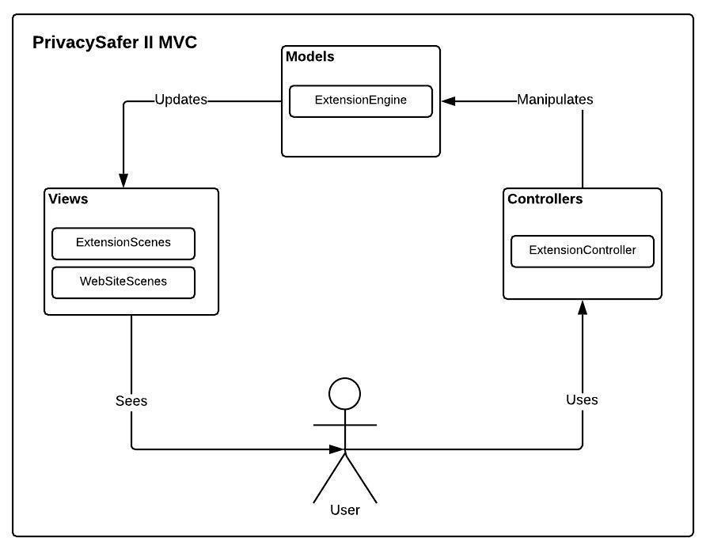
PrivacySaferII

Slide 9
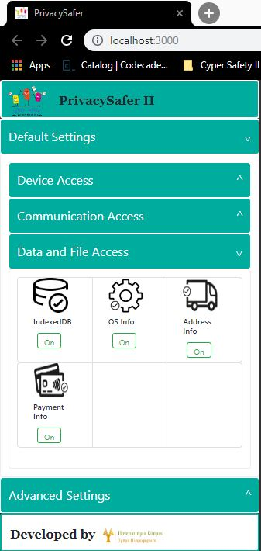
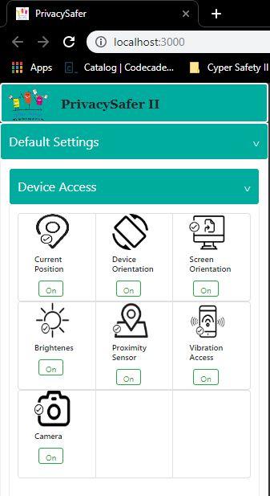
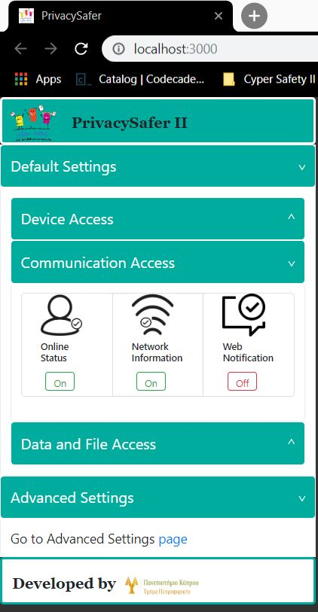

Slide 10
T4.2 Development of an application analysis toolset
Web-based toolset that analyses mobile/web applications and reports sensitive data they request from users
Allows users to upload a mobile application (in the form of .apk file for Android) or reference the URL of a website
Provide feedback to the users on the kind of personal data the respective application or website requires
Notes:
2 versions: one for students (aged 12-17),one for parents (i.e., adults)
Collaboration with Activity 1 - The procedure for uninstalling and subsequently requesting the deletion of sensitive or private information will be established under the Awareness activity and will reference compliance with the GDPR

Slide 11
T4.2 Development of an application analysis toolset
Deliverables
D.4.2.1. Tool requirements analysis
D.4.2.2. Tool design
D.4.2.3. Tool implementation and testing (2 variants of the tool, for students and parents) – 1st version expected 11/2019
D.4.2.4. Tool user guidelines

Slide 12
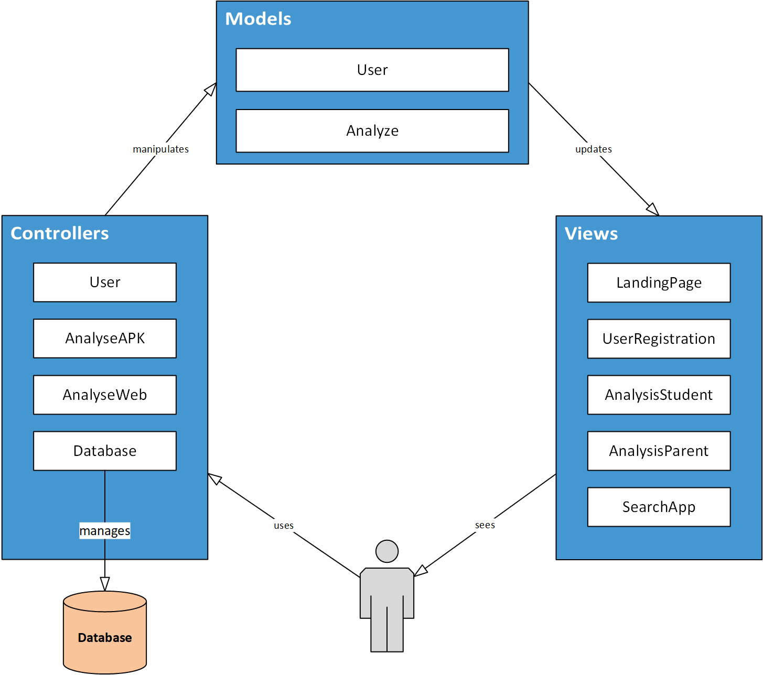
Awareness analysis tool (Activity 4)
Web application
Build with MVC model
Views:
Landing Page: prompt users to register
User Registration
Registered Users:
Search for analyzed apps
View analysis results depending on user type (child/parent)
Analyse a new application

Slide 13

Software stack: Frontend
Frontend:
vue.js:
JavaScript framework
Open Source
Modern, Popular
Plays well with our backend
Builds user interface
Single-page applications

Slide 14


Software stack: Backend
Backend:
Laravel:
PHP framework
Open Source
Modern, Popular
Fast, lightweight!
MVC architecture
Modular
Deployed:
Apache Web Server
MariaDB:
Relational Database

Slide 15
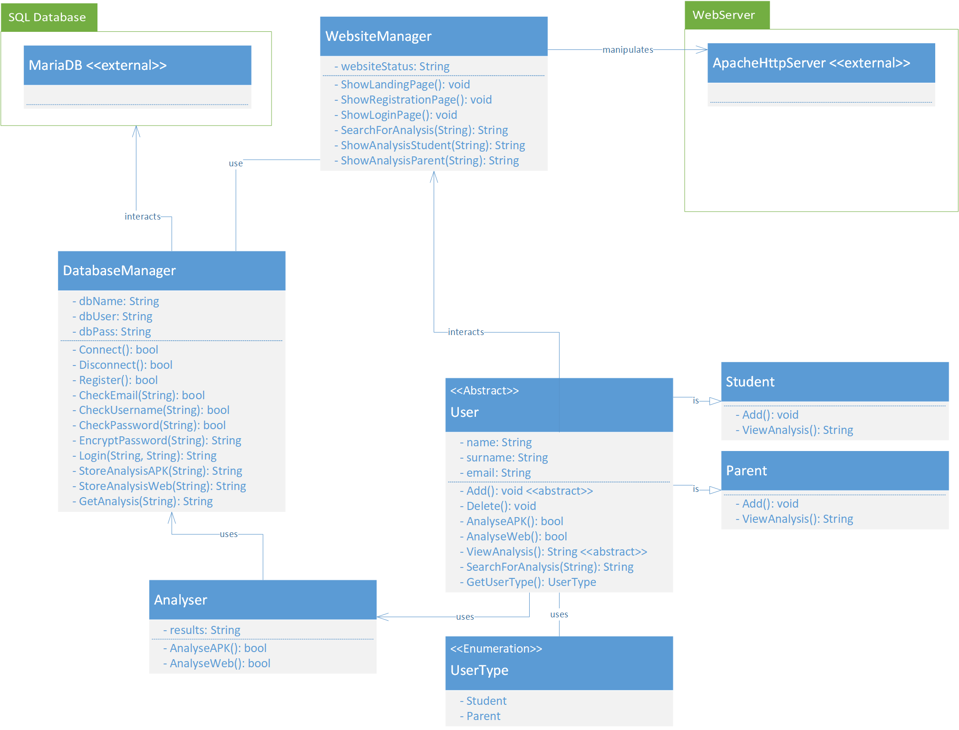
Architecture
Views
DB
Server
DB:
DatabaseManager:
Connections to database
Apache HTTP Server:
Serve the Views
User model:
Student or Parent
Interact with database
Content of the Views
External Tools:
Developed as standalone tools
Called by Laravel
Analyse APKs and Websites
DB
Model
ExternalTools

Slide 16
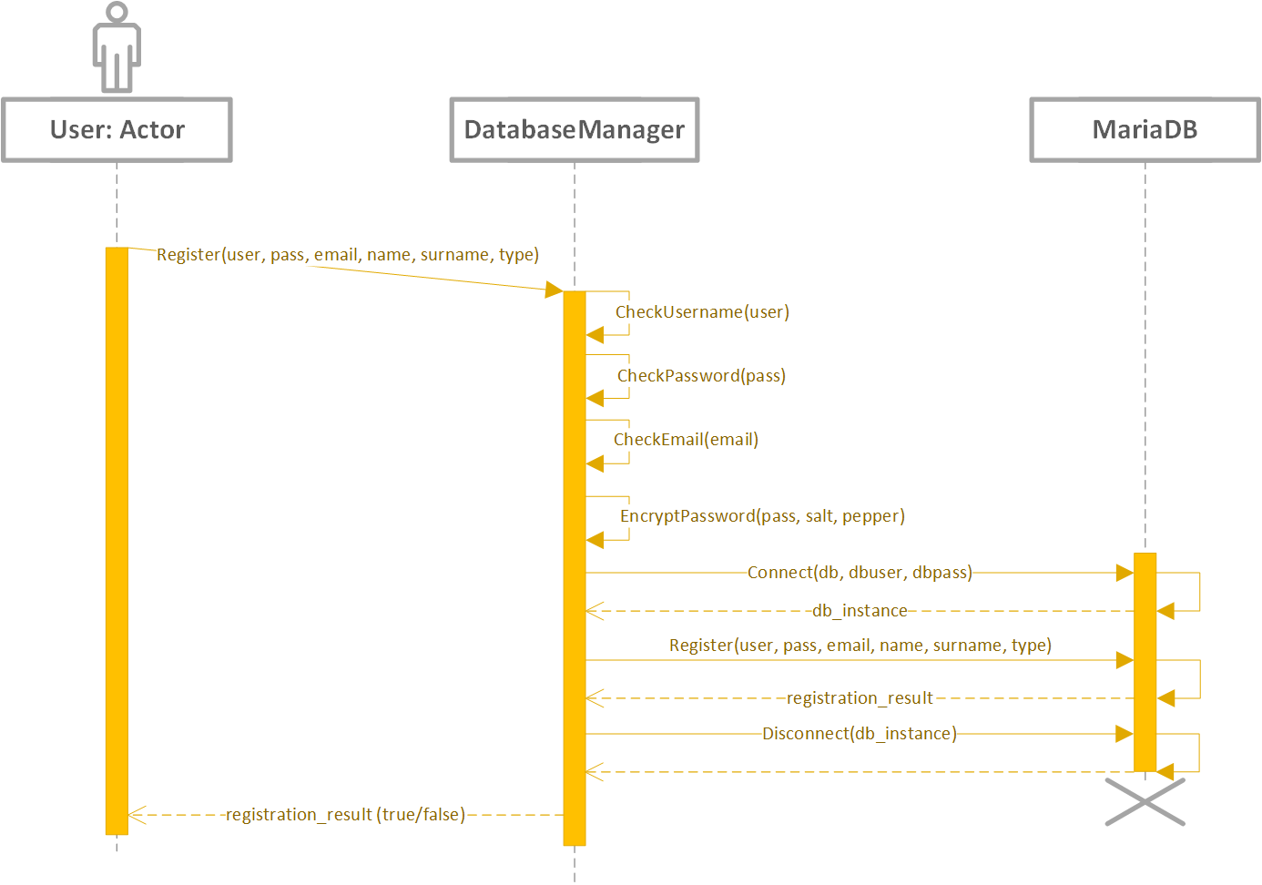
Registration Process (example)
Accept user data
In “register” view
Form validation:
Frontend:
HTML5 constraints, e.g. email
Vue.js: interactive & user friendly
Backend:
Laravel custom validators
Database:
Reject changes
Show error
(should never reach here!)
Store to database

Slide 17
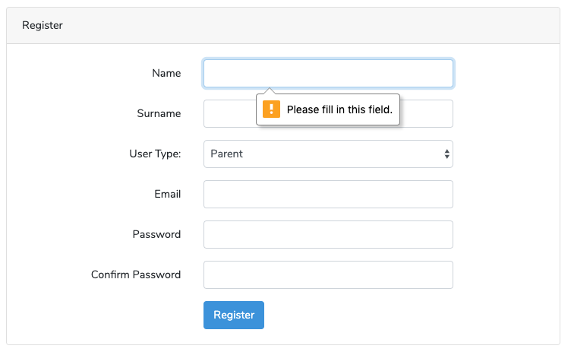
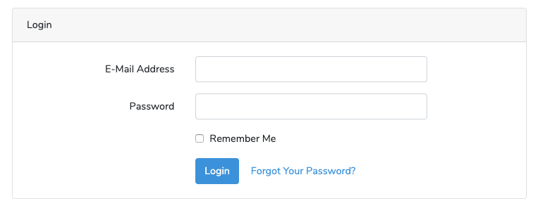
Registration Process (example)
Accept user data
Store to database
Login:
Access website services

Slide 18
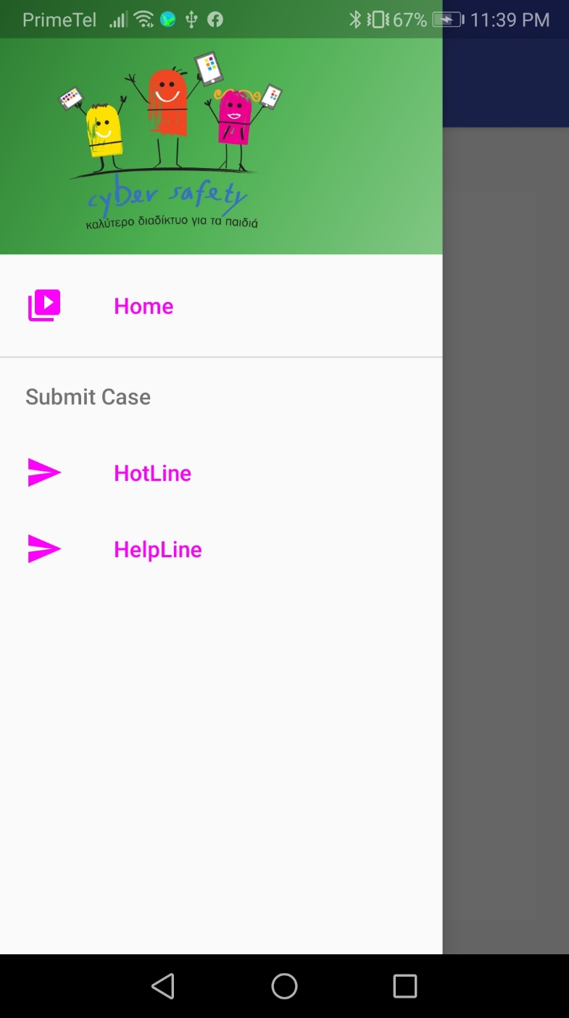
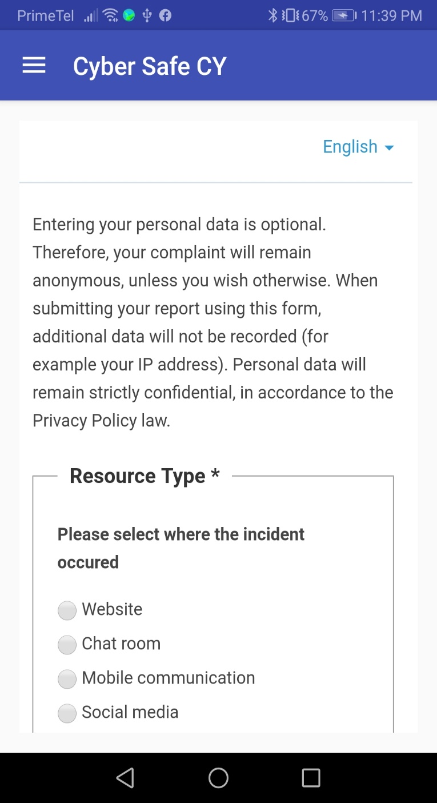
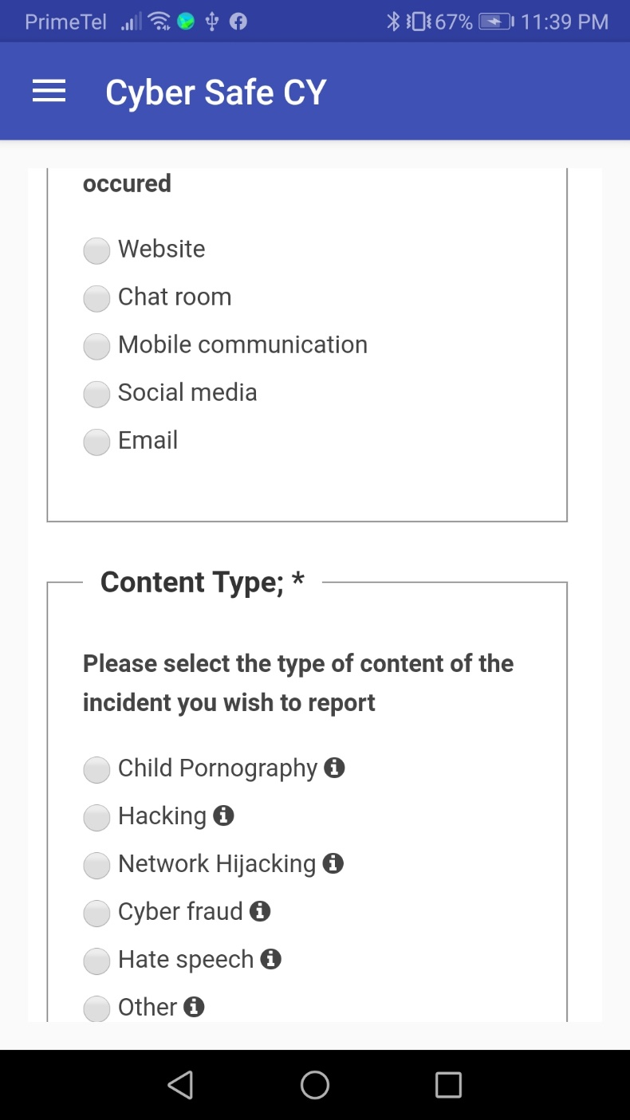
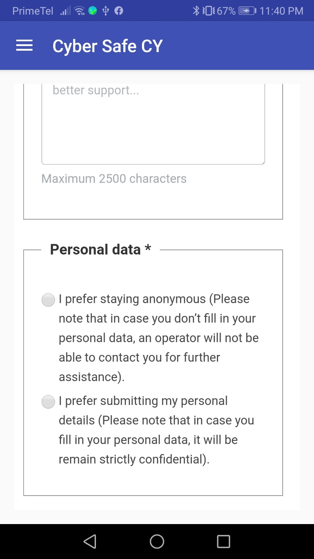
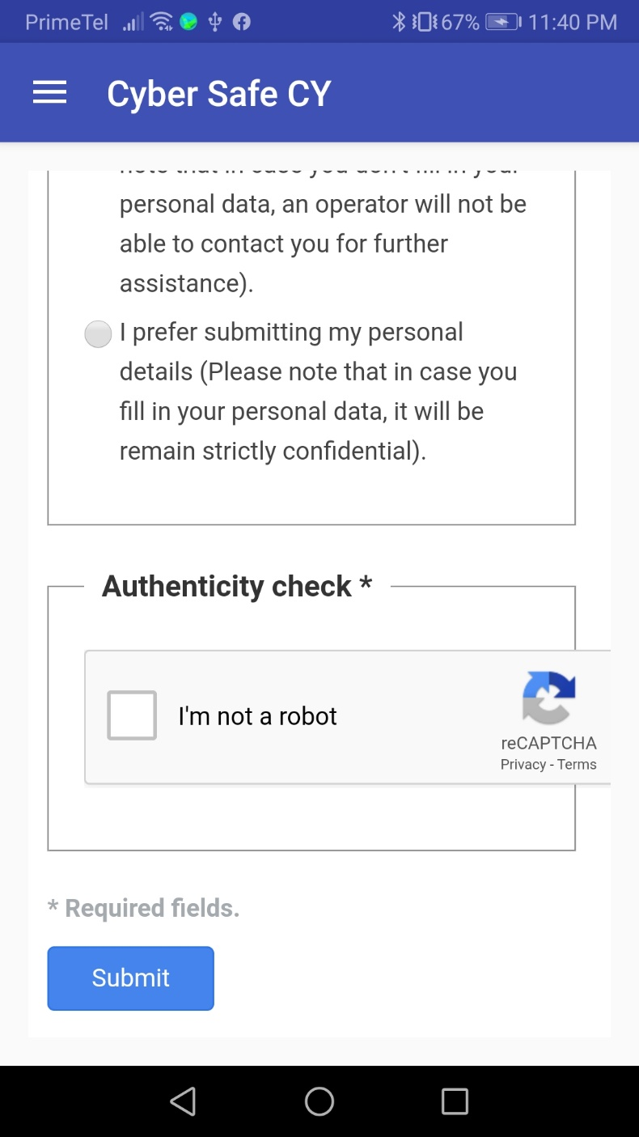
CyberSafe Android Application
Cyber Safety in Children Hands!

Slide 19
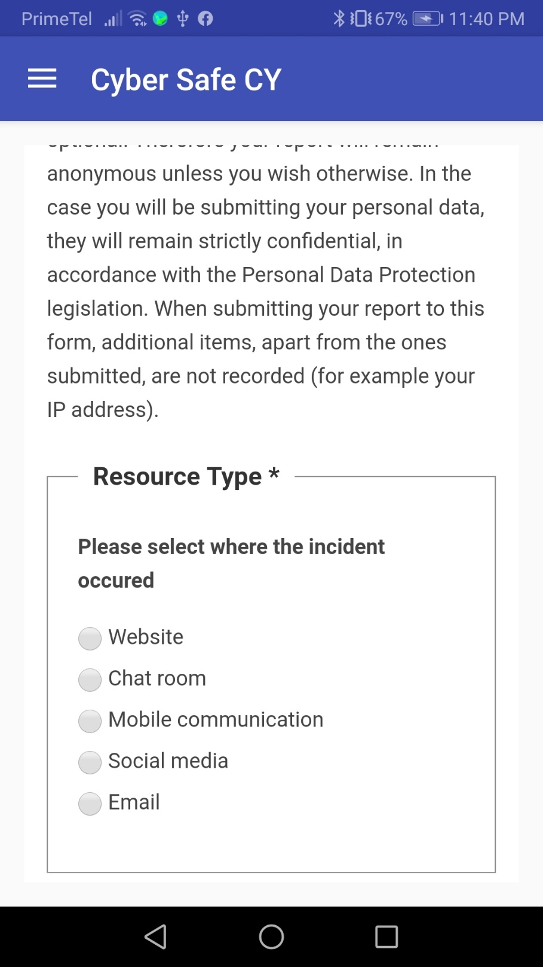
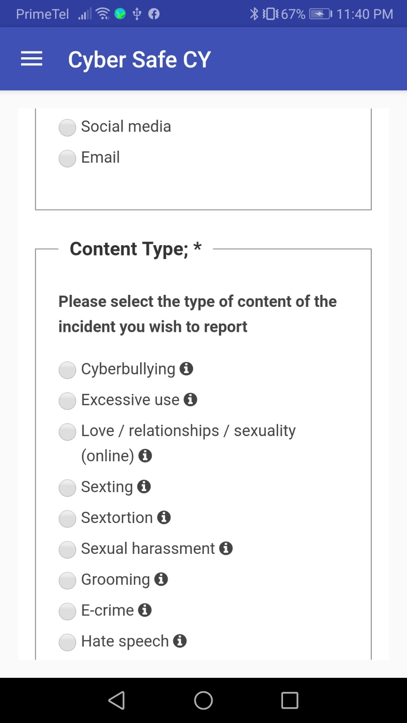
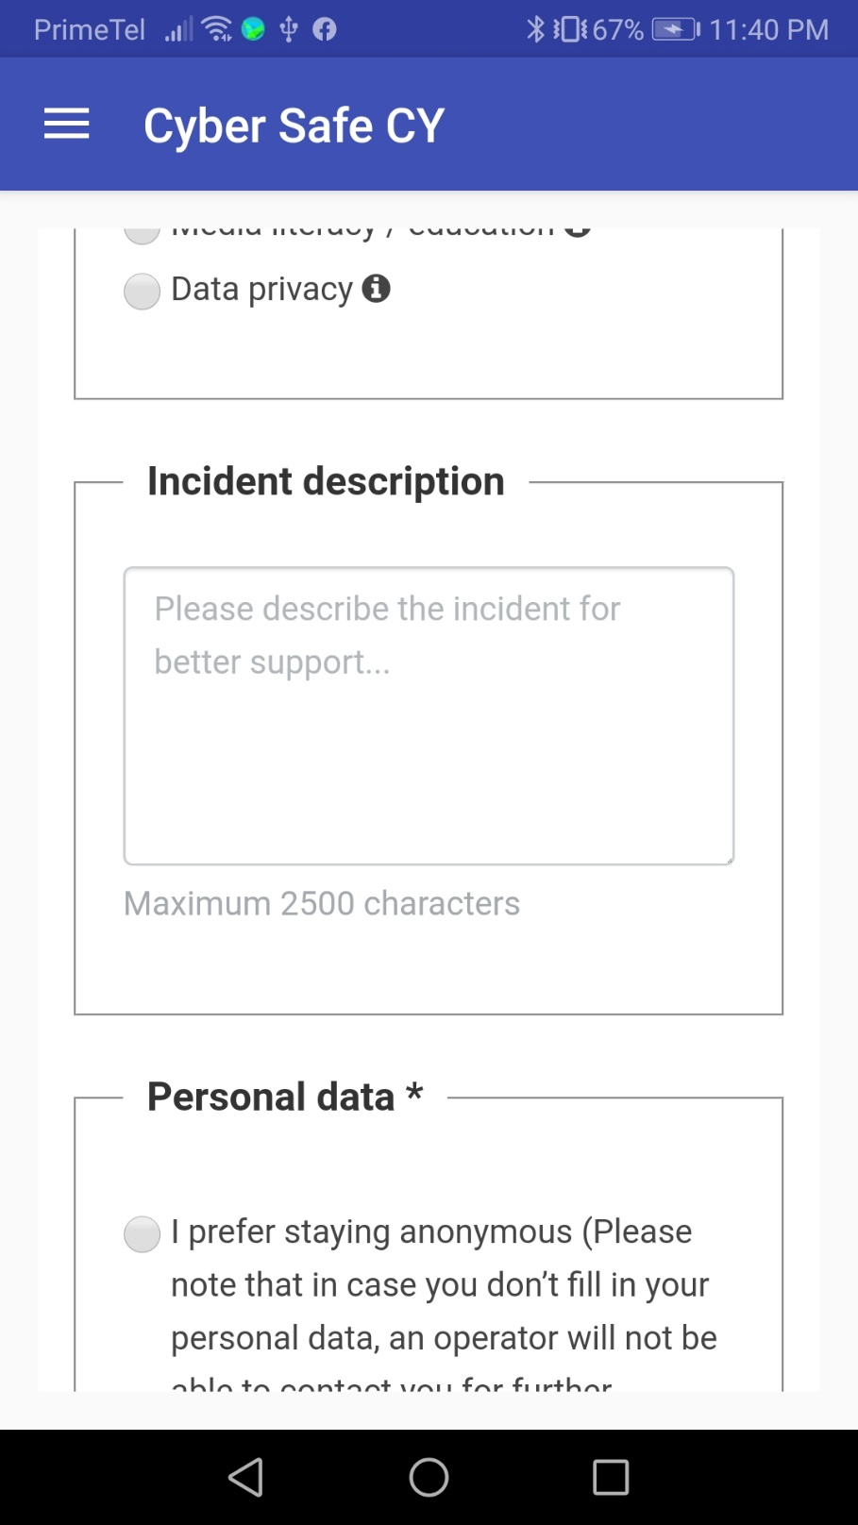
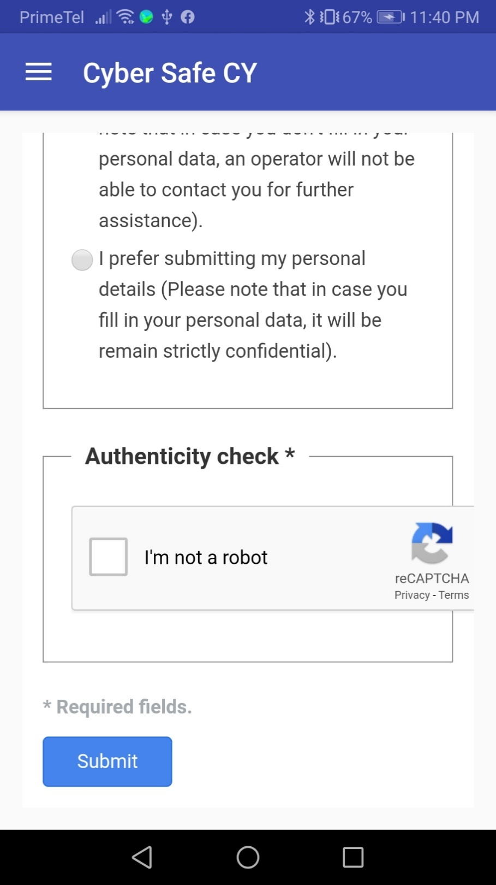
CyberSafe Android Application

